Slide 1
ISO27001:2013 Controls Appendix; Part 2
Lets continue to have a look at the ISO27001:2013 (ISMS) controls (appendix) in more detail…

Slide 2

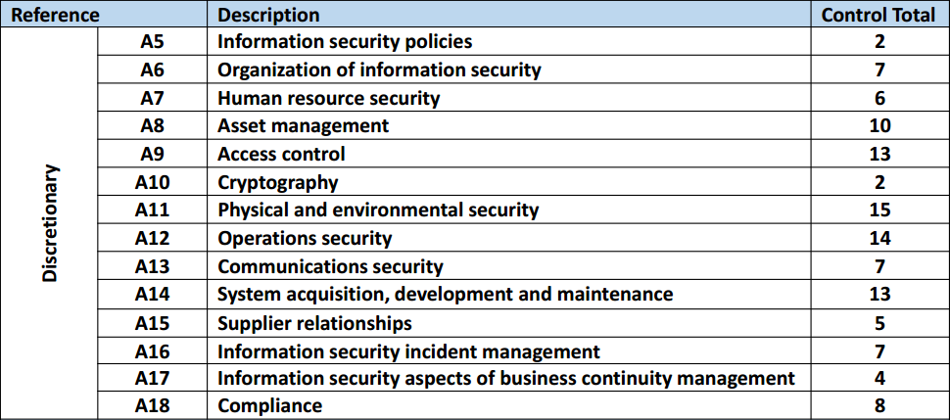
ISO27001:2013 Controls Appendix; Part 2
ISO27001:2013 DISCRETIONARY CONTROLS
TOTAL: 114
https://chapters.theiia.org/bermuda/Events/ChapterDocuments/Information%20Security%20Management%20System%20%28ISMS%29%20Overview.pdf

Slide 3
ISO27001:2013 Controls Appendix; Part 2
A.7 HUMAN RESOURCES SECURITY
A.7.1 PRIOR TO EMPLOYMENT
Objective: To ensure that employees and contractors understand their responsibilities and are suitable for the roles for which they are considered.

Slide 4
ISO27001:2013 Controls Appendix; Part 2
A.7 HUMAN RSOURCES SECURITY
A.7.1 PRIOR TO EMPLOYMENT
A.7.1.1 | SCREENING
A.7.1.2 | TERMS & CONDITIONS OF EMPLOYMENT
A.7.2 DURING EMPLOYMENT
A.7.2.1 | MANAGEMENT RESPONSIBILITIES
A.7.2.2 | INFOSEC AWARENESS, EDUCATION & TRAINING
A.7.2.3 | DISCIPLINARY PROCESS

Slide 5
ISO27001:2013 Controls Appendix; Part 2
A.7 HUMAN RESOURCES SECURITY
A.7.1.1 | SCREENING | Control: Background verification checks on all candidates for employment shall be carried out in accordance with relevant laws, regulations & ethics and shall be proportional to the business requirements, the classification of the information to be accessed and the perceived risks.

Slide 6
ISO27001:2013 Controls Appendix; Part 2
A.7 HUMAN RESOURCES SECURITY
A.7.1.2 | TERMS & CONDITIONS OF EMPLOYMENT | Control: The contractual agreements with employees and contractors shall state their and the organization’s responsibilities for information security.

Slide 7
ISO27001:2013 Controls Appendix; Part 2
A.7 HUMAN RSOURCES SECURITY
A.7.2 DURING EMPLOYMENT
A.7.2.1 | MANAGEMENT RESPONSIBILITIES
A.7.2.2 | INFOSEC AWARENESS, EDUCATION & TRAINING
A.7.2.3 | DISCIPLINARY PROCESS

Slide 8
ISO27001:2013 Controls Appendix; Part 2
A.7 HUMAN RESOURCES SECURITY
A.7.2.1 | MANAGEMENT RESPONSIBILITIES | Control: Management shall require all employees and contractors to apply information security in accordance with the established policies and procedures of the organization.

Slide 9
ISO27001:2013 Controls Appendix; Part 2
A.7 HUMAN RSOURCES SECURITY
A.7.3 TERMINATION & CHANGE OF EMPLOYMENT
A.7.3.1 | TERMINATION OR CHANGE OF EMPLOYMENT RESONSIBILITIES

Slide 10
ISO27001:2013 Controls Appendix; Part 2
A.7 HUMAN RSOURCES SECURITY
A.7.3.1 | TERMINATION OR CHANGE OF EMPLOYMENT RESONSIBILITIES | Control: Information security responsibilities and duties that remain valid after termination or change of employment shall be defined, communicated to the employee or contractor and enforced

Slide 11
ISO27001:2013 Controls Appendix; Part 2
Lets look at asset management in the next module…
END

